Slide 1
Supporting Writing at Key Stage 2
How can parents support children in their development as writers?

Slide 2
Aims for this session:
Understand the writing assessment criteria: What do students have to do to achieve Age-Related Expectations at the end of Year 6?
Understand how to support your children’s writing: What can we as parents do to help them?

Slide 3
What makes writing difficult?
Historically, students perform better in SATs reading papers than writing assessments – and fewer of our KS2 students are currently achieving Age-Related Expectations and Greater Depth for writing compared with reading.
Why is this?
What can we do about it?

Slide 4
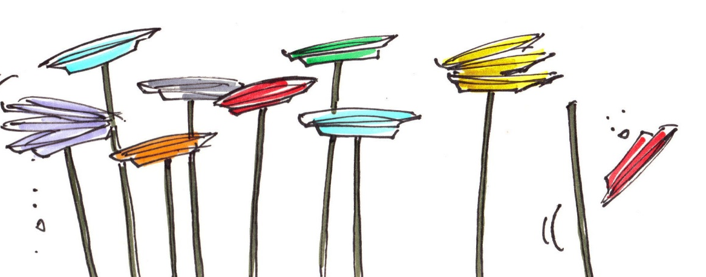
Why is this?
Writing is a complex combination of skills: imagination, understanding of audience and purpose, understanding of genre, sentence structure, vocabulary choice, handwriting, punctuation and spelling.
What can we do to make it easier?

Slide 5
Rank these suggestions, 1 being the most useful…
Reading with your child
Talking about a shared experience
Buying a SATs question book
Writing something yourself (a card, shopping list, email)
Going for a walk
Helping them make a clay model
Discussing a story in the news
Introducing and explaining new vocabulary
Talking about a favourite scene in a film
Encouraging your child to write a diary
Singing a song to or with your child

Slide 6
Foundations for Writing
Talking – informal and formal contexts
Reading – types of texts, genres
General knowledge – curiosity about different topics
Ability to make connections – logical thinking
Observational skill – noticing and describing details
Formulating ideas into sentences

Slide 7
Age-Related Expectations (ARE) for Year 6
The pupil can:
• write effectively for a range of purposes and audiences, selecting language that shows good awareness of the reader (e.g. the use of the first person in a diary; direct address in instructions and persuasive writing)
• in narratives, describe settings, characters and atmosphere
• integrate dialogue in narratives to convey character and advance the action

Slide 8
• use verb tenses consistently and correctly throughout their writing
• use the range of punctuation taught at key stage 2 mostly correctly (e.g. inverted commas and other punctuation to indicate direct speech)
• spell correctly most words from the year 5 / year 6 spelling list, and use a dictionary to check the spelling of uncommon or more ambitious vocabulary
• maintain legibility in joined handwriting when writing at speed

Slide 9
ARE: Select vocabulary and grammatical structures that reflect what the writing requires, doing this mostly appropriately (e.g. using contracted forms in dialogues in narrative; using passive verbs to affect how information is presented; using modal verbs to suggest degrees of possibility)
GD: Exercise an assured and conscious control over levels of formality, particularly through manipulating grammar and vocabulary to achieve this.
Encourage your child to rephrase a conversational comment as if they were talking to a teacher/ unfamiliar adult
E.g. “Mum! Help!” ~ “Some assistance would be appreciated.”

Slide 10
Using passive and modal verbs mostly appropriately
What are passive and modal verbs??

Slide 11
Passive verbs
Verbs are active when the subject of the sentence does the action: the dog ate the bone.
Verbs are passive when the subject of the sentence has the action done to it: the bone was eaten by the dog.
E.g:
The suspect was arrested late on Thursday night.
The last slice of cake has been eaten.

Slide 12
Modal Verbs
These are special auxiliary (additional/helping) verbs which express possibility, obligation or ability
can, will, shall, could, would, should, may, might, must

Slide 13
What you can do to help
Read impersonal styles of text, e.g. instructions, newspaper articles, (First News)
Discuss plans for the weekend ahead (could we…); possibilities or hopes for the future (I might be able to…); things that could have happened differently in the past (they could have…)

Slide 14
Use a range of devices to build cohesion (e.g. conjunctions, adverbials of time and place, pronouns, synonyms) within and across paragraphs
Cohesive devices – word and phrases to link ideas together; e.g. conjunctions such as: because, while, although
Adverbials – an adverb, adverbial phrase or adverbial clause which gives additional information about time, manner or place; e.g. she walked contentedly through the garden in the heat of the afternoon.

Slide 15
Helping with Home Learning:
Encourage your child to teach you the skills and concepts they have learned about in class and explain what they have to do before they actually do it
Support them with aspects of writing that they may find particularly challenging (e.g. spelling, handwriting, sentence structure)
Encourage them to read their writing aloud to you, so that they can identify grammatical errors and reflect on potential improvements

Slide 16
Greater Depth
• Write effectively for a range of purposes and audiences, selecting the appropriate form and drawing independently on what they have read as models for their own writing (e.g. literary language, characterisation, structure)
• Distinguish between the language of speech and writing and choose the appropriate register
• Use the range of punctuation taught at key stage 2 correctly (e.g. semi-colons, dashes, colons, hyphens) and, when necessary, use such punctuation precisely to enhance meaning and avoid ambiguity

Slide 17
Remember
Talk up to children – have high expectations of the vocabulary and content they can cope with – you can always answer questions and rephrase!
Exploit opportunities – for exploring language everywhere.
Encourage children out of their reading comfort zone.
Build the foundations for writing.

